Slide 1
Cool Dataset Presentation
C0₂ emissions per country

Slide 2
Datasets
Emissions by Country
World, Region, Country GDP
Country
Year (1750-2021)
Total CO2 emissions
Coal
Oil
Gas
Cement
Flaring
Others
Per Capita
Country
Year (1960-2021)
GDP_USD
The Global Carbon Project (GCP)
Data World Bank
Licenses: CC0 (Public Domain)

Slide 3
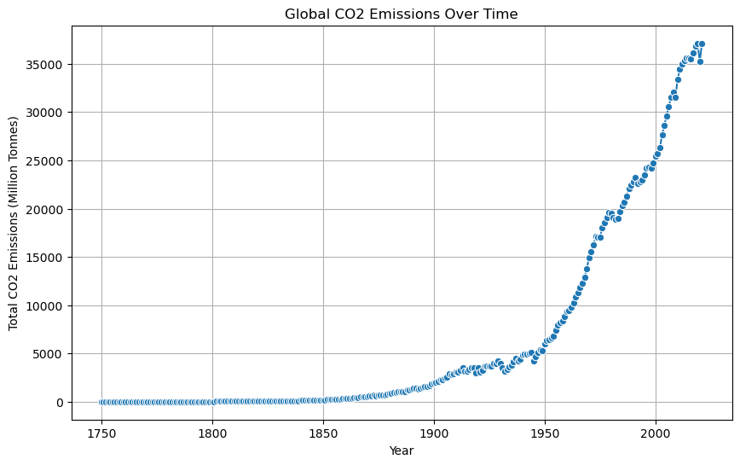
Global CO2 emissions evolution

Slide 4
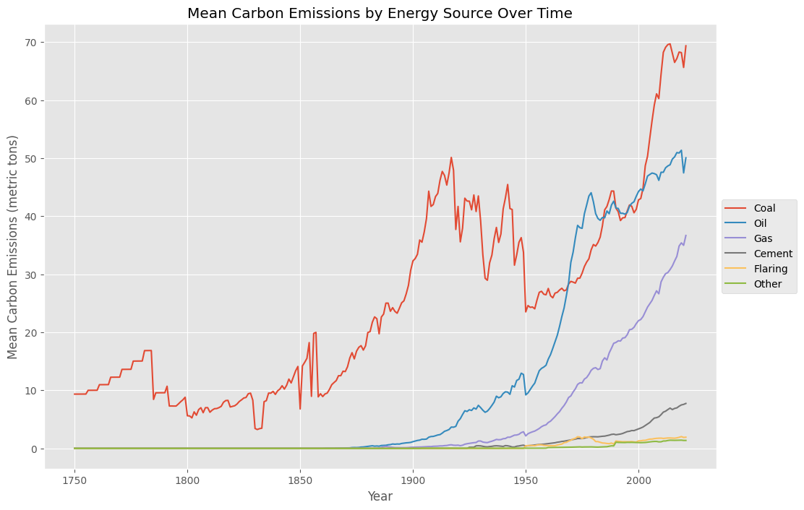
Mean Carbon Emissions by Energy Source

Slide 5
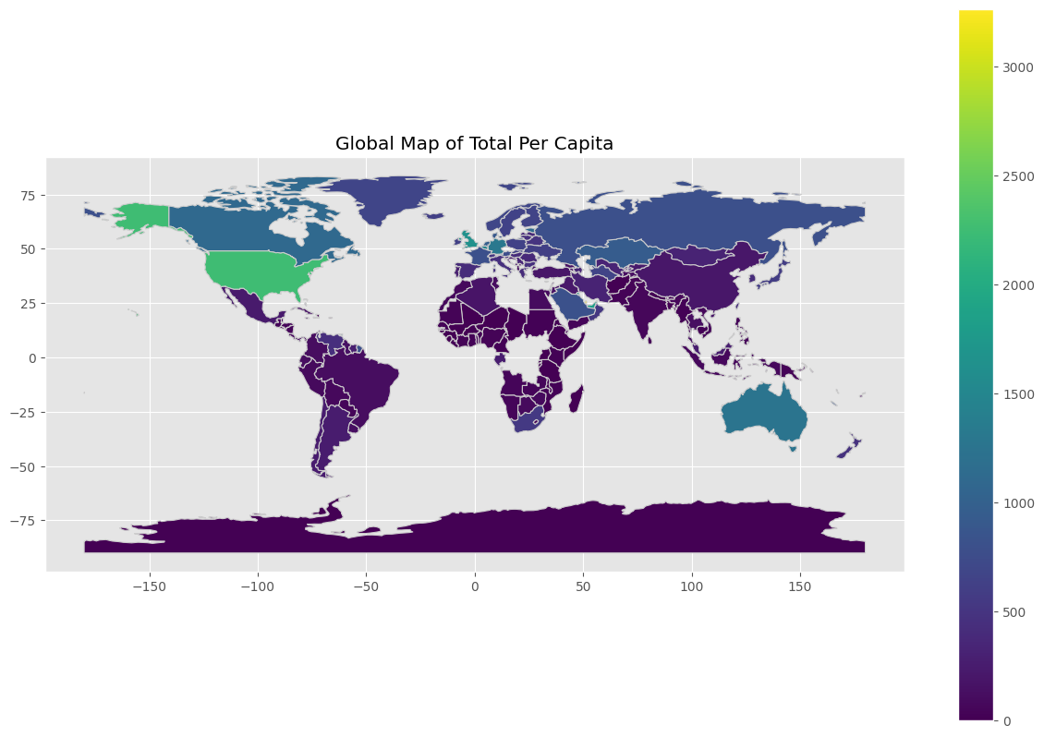
Global Map of Total CO2 Emissions per capita

Slide 6
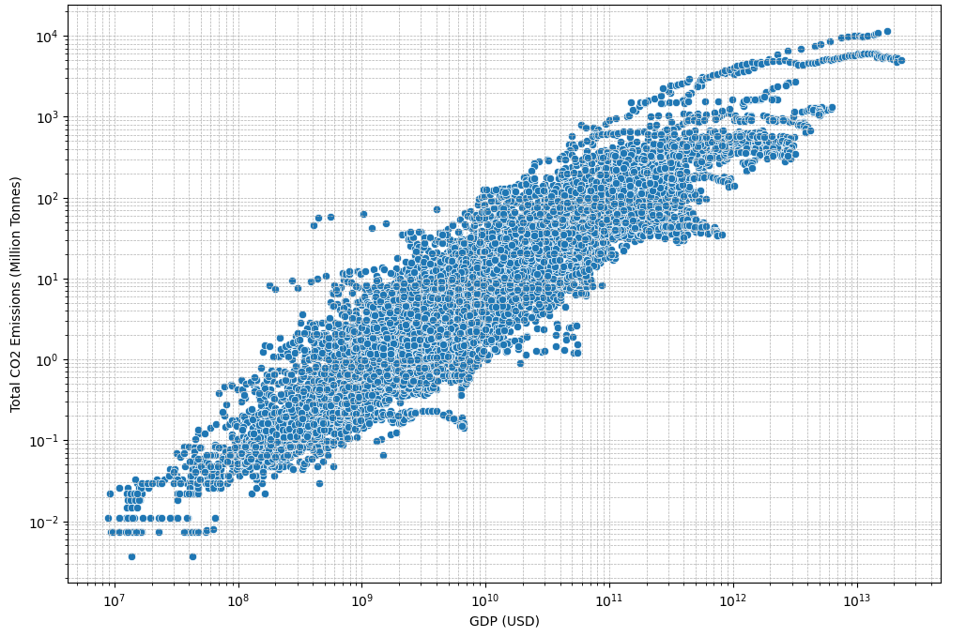
Comparison of GDP and CO2 Emissions

Slide 7
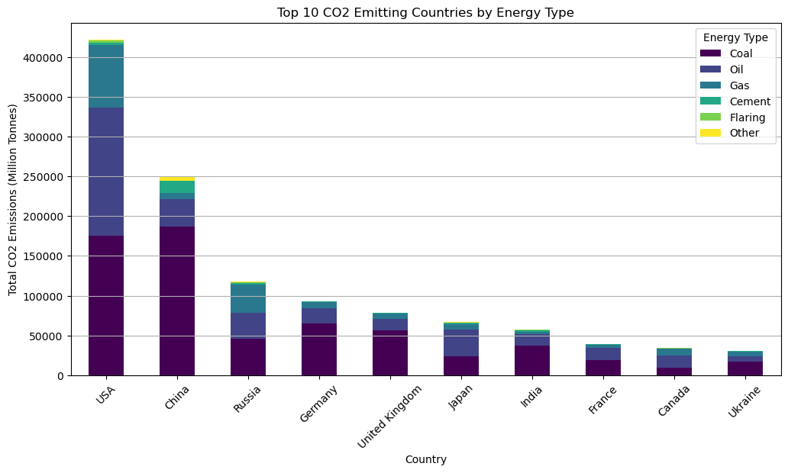
Top 10 CO2 Emitting Countries

Slide 8
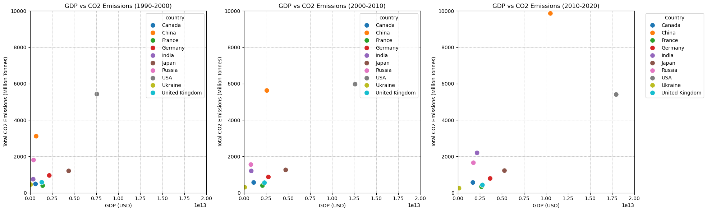
GDP vs CO2 Emissions
1990-2000
2000-2010
2010-2020

Slide 9
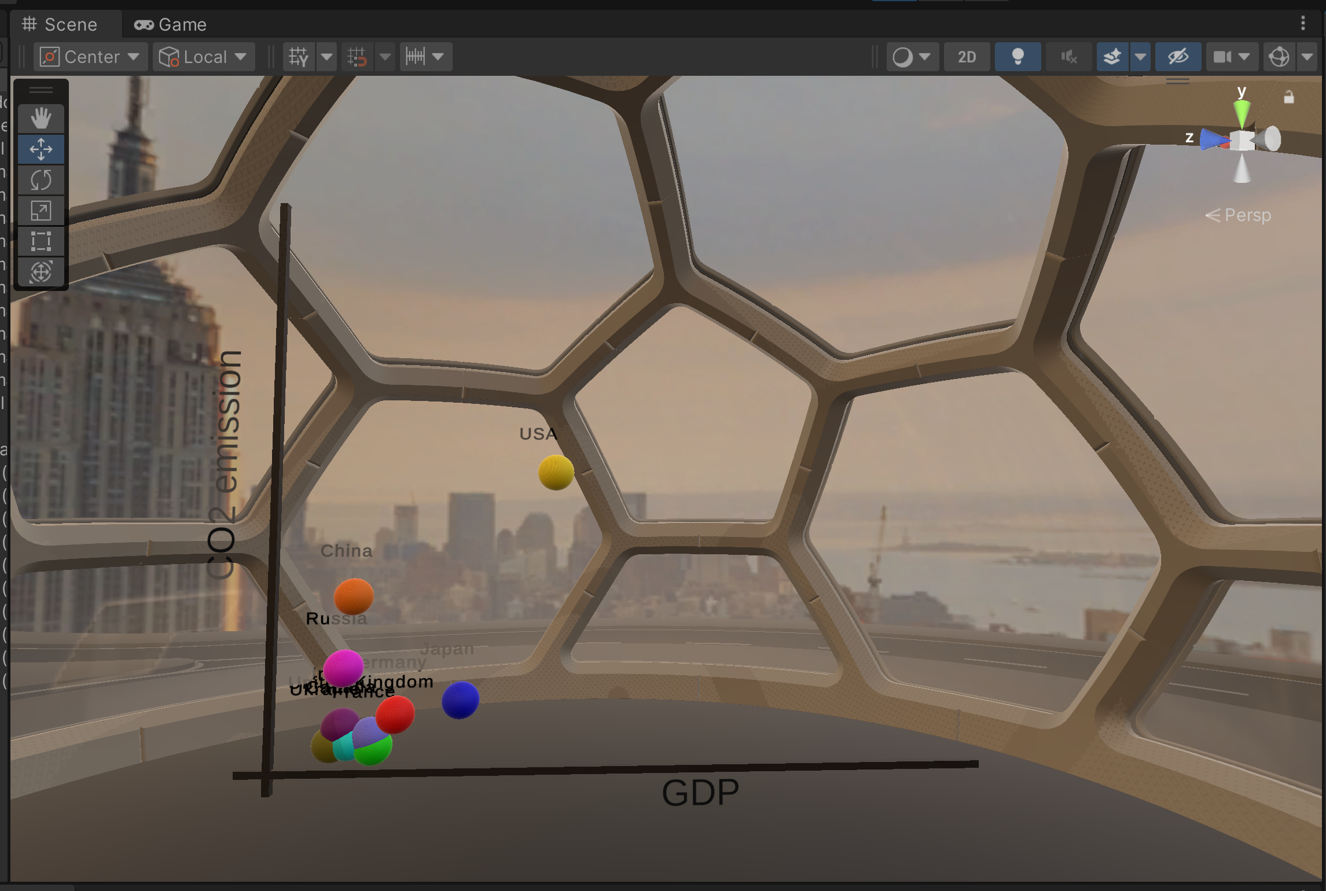
[Unity Demo]

Slide 10
Thank you!

